Slide 1

Chandigarh School of Business, Jhanjeri
Department of Computer Application
Program Code:NA
Program Name: MCA
Course Code: PGCA1937
Course Name: Cloud Computing
Prepared by: Dr. Gurvir Kaur

Slide 2

Outlines
PTU Syllabus of Unit-I
CO’s Introduction
Topic Overview
Brief description of what the presentation will cover
Importance or relevance of the topic
Key objectives or learning outcomes
Summary
References

Slide 3
PTU Syllabus of Unit-I
Part-A
Overview of Computing Paradigm: Recent trends in Computing -Grid Computing, Cluster Computing, Distributed Computing, Utility Computing, Cloud Computing.
Introduction to Cloud Computing: Vision of Cloud Computing, Defining a Cloud, Cloud Reference Model, Deployment Model, Characteristics, Benefits of Cloud Computing, Challenges ahead. Cloud computing vs. Cluster computing vs. Grid computing.
Migrating into a Cloud: Introduction, Broad approaches to Migrating into the Cloud, The Seven-Step Model of Migration Into a Cloud.
Virtualization: Introduction, Characteristics of Virtualized environment, Taxonomy of Virtualization techniques, Virtualization and Cloud Computing, Pros and Cons of Virtualization, Technology Examples- Xen, VMware, Microsoft Hyper-V.
Capacity Planning: Introduction, Defining Baseline and Metrics-Baseline Measurements, System Metrics, Load Testing, Resource Ceilings, Server and Instance types; Network Capacity, Scaling.

Slide 4
Key objectives or learning outcomes
CO1 Understand the basic concept and importance of cloud computing.
CO2 Access the suitability of migrating to a cloud solution for different applications.
CO3 Compare and evaluate the virtualization technologies.
CO4 Monitor and manage the cloud resources, applications and data while addressing the security concerns.
CO5 Use cloud solutions offered by industry leaders for various applications.

Slide 5
CO Introduction
CO NUMBER | TOPICS | LEVEL
CO1 | Overview of Computing Paradigm: Recent trends in Computing -Grid Computing, Cluster Computing, Distributed Computing, Utility Computing, Cloud Computing. Introduction to Cloud Computing: Vision of Cloud Computing, Defining a Cloud, Cloud Reference Model, Deployment Model, Characteristics, Benefits of Cloud Computing, Challenges ahead. Cloud computing vs. Cluster computing vs. Grid computing. | 2

Slide 6
Topic Overview
Cluster computing involves connecting multiple computers (nodes) to work together as a unified system to perform large-scale computational tasks. This configuration improves performance, reliability, and scalability by distributing workloads across several machines, which can work in parallel on complex problems.
The main benefits of cluster computing include enhanced processing power, high availability (through redundancy and fault tolerance), and scalability (easy addition of more nodes).

Slide 7
Brief of what the presentation will
The presentation will cover the following points:
Trends in Computing
Cluster Computing
Types
Components
Benefits

Slide 8
Importance of the topic
Scalability and Flexibility: Cloud computing provides on-demand access to a vast range of resources, enabling businesses to scale up or down based on their needs.
Cost Efficiency: By using cloud services, businesses can significantly reduce costs associated with maintaining and upgrading physical hardware.
Accessibility and Collaboration: Cloud computing allows users to access data and applications from any device with an internet connection, facilitating remote work and global collaboration. This enhances productivity, supports flexible work environments, and enables real-time collaboration across teams and locations.

Slide 9
Detail Topics
The ACM Computing Curricula 2005 defined "computing" as
"In a general way, we can define computing to mean any goal-oriented activity requiring, benefiting from, or creating computers. Thus, computing includes designing and building hardware and software systems for a wide range of purposes; processing, structuring, and managing various kinds of information; doing scientific studies using computers; making computer systems behave intelligently; creating and using communications and entertainment media; finding and gathering information relevant to any particular purpose, and so on. The list is virtually endless, and the possibilities are vast."

Slide 10
What is Cluster
Computing?
A cluster is a type of parallel or distributed computer system, which consists of a collection of inter-connected stand-alone computers working together as a single integrated computing resource .
Key components of a cluster include multiple standalone computers (PCs, Workstations, or SMPs), operating systems, high-performance interconnects, middleware, parallel programming environments, and applications.

Slide 11
Cluster Computing?
Clusters are usually deployed to improve speed and/or reliability over that provided by a single computer, while typically being much more cost effective than single computer the of comparable speed or reliability
In a typical cluster:
  Network: Faster, closer connection than a typical network (LAN)
  Low latency communication protocols
  Loosely coupled than SMP

Slide 12
Types of Cluster
High Availability or Failover Clusters
Load Balancing Cluster
Parallel/Distributed Processing Clusters

Slide 13
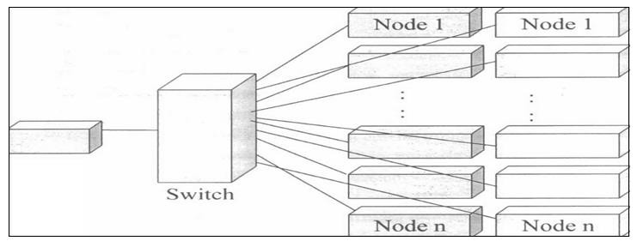
Cluster Components
Basic building blocks of clusters are broken down into multiple categories:
  Cluster Nodes
  Cluster Network
  Network Characterization

Slide 14
Key Operational Benefits of Clustering
System availability: offer inherent high system availability due to the redundancy of hardware, operating systems, and applications.
Hardware fault tolerance: redundancy for most system components (eg. disk-RAID), including both hardware and software.
OS and application reliability: run multiple copies of the OS and applications, and through this redundancy
Scalability. adding servers to the cluster or by adding more clusters
to the network as the need arises or CPU to SMP.
High performance: (running cluster enabled programs)

Slide 15
Summary
Cluster computing refers to a system where multiple interconnected computers (nodes) work together to perform tasks. These nodes communicate over a network to appear as a single system, sharing resources like processing power and storage.
Cluster computing offers high scalability by adding more nodes to handle increased workloads. It improves performance by distributing tasks across nodes, enabling parallel processing and faster execution of complex computations.
Clusters are designed for high availability. If one node fails, others can take over its tasks, ensuring minimal disruption. Redundancy and fault-tolerant configurations help maintain continuous service even in the case of hardware failures.
Cluster computing is used in a wide range of fields, such as scientific research, big data processing, financial modeling, cloud computing, and machine learning.

Slide 16
References
Books References
Mastering Cloud Computing, Rajkumar Buyya, Christian Vecchiola, and ThamaraiSelvi, Tata McGraw Hill, ISBN-13: 978-1-25-902995-0, New Delhi, India,Feb 2013.
E-book link
https://archive.org/details/cloudcomputingbi0000sosi
YouTube link
https://www.youtube.com/@cloudcomputing351/videos
https://www.geeksforgeeks.org/cloud-computing/
https://www.tutorialspoint.com/cloud_computing/index.htm
https://nptel.ac.in/courses/106105167
https://www.edx.org/learn/cloud-computing

Slide 17
THANK YOU

